Slide 1


ENERGY CONSUMPTION PROJECT
BY AKEEB QUADRI AKOLAWOLE
GREEN ENERGY COMPANY
YEAR 2022

Slide 2
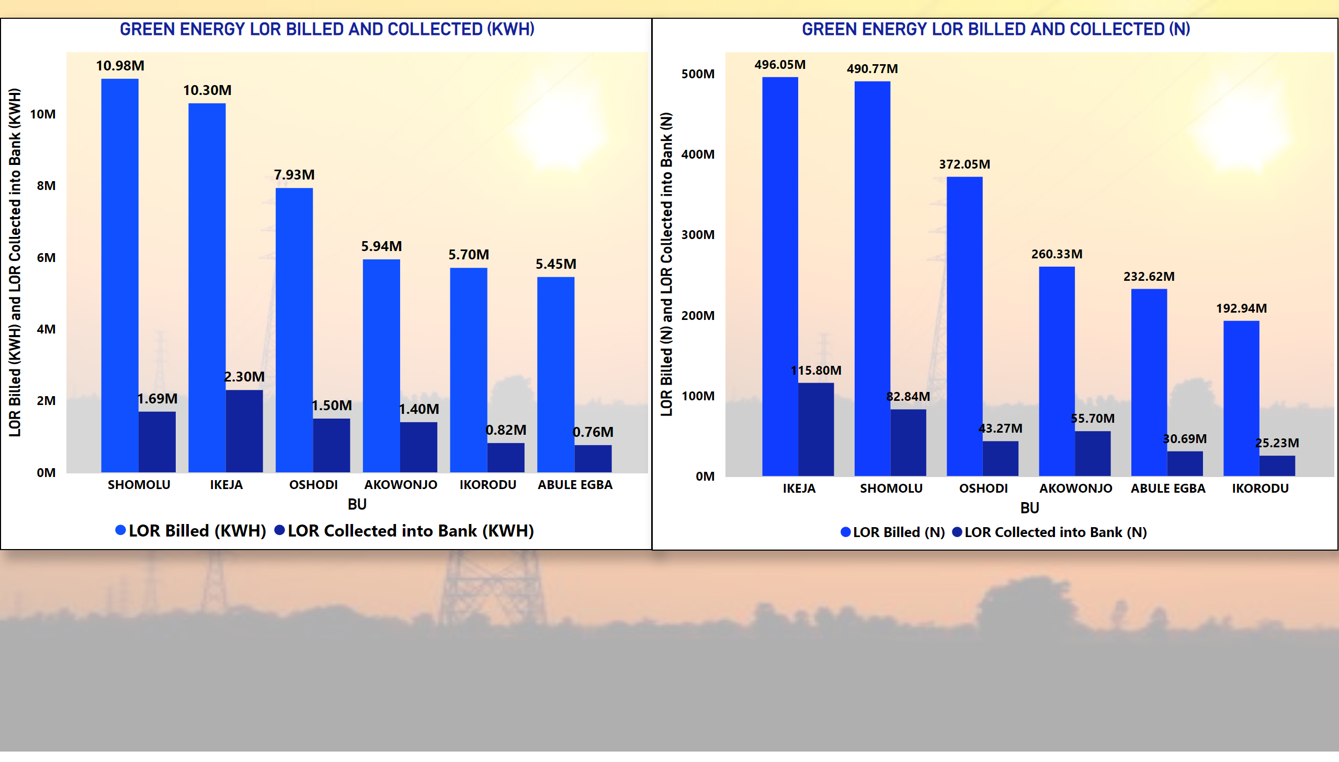
LOR BILLED AND COLLECTED
Notes:
GREEN ENERGY LOR BILLED AND COLLECTED (KWH)
No alt text provided
GREEN ENERGY LOR BILLED AND COLLECTED (N)
No alt text provided

Slide 3
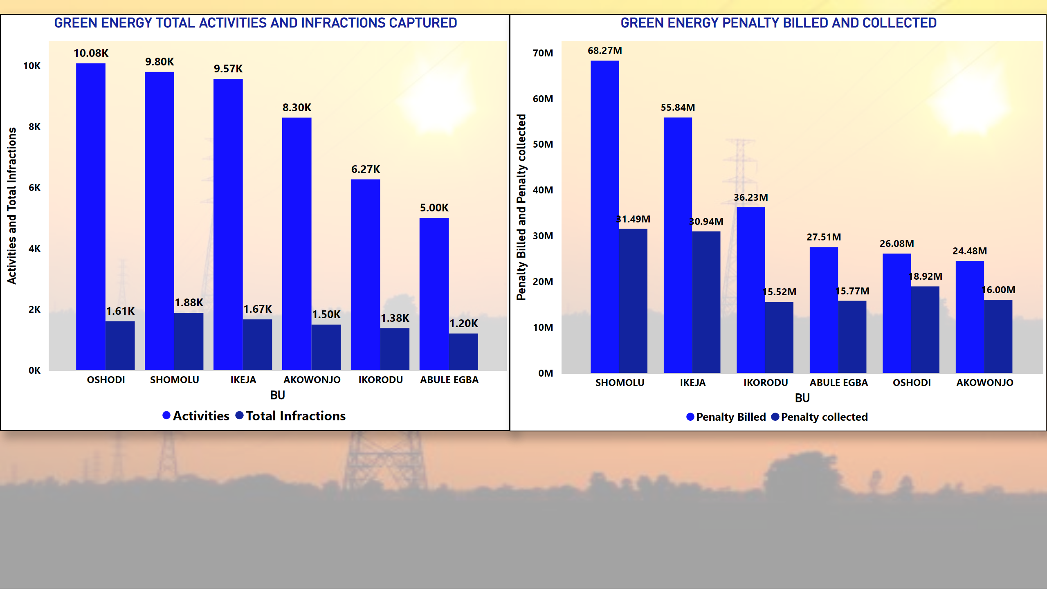
BU PERFORMANCE
Notes:
GREEN ENERGY TOTAL ACTIVITIES AND INFRACTIONS CAPTURED
No alt text provided
GREEN ENERGY PENALTY BILLED AND COLLECTED
No alt text provided

Slide 4
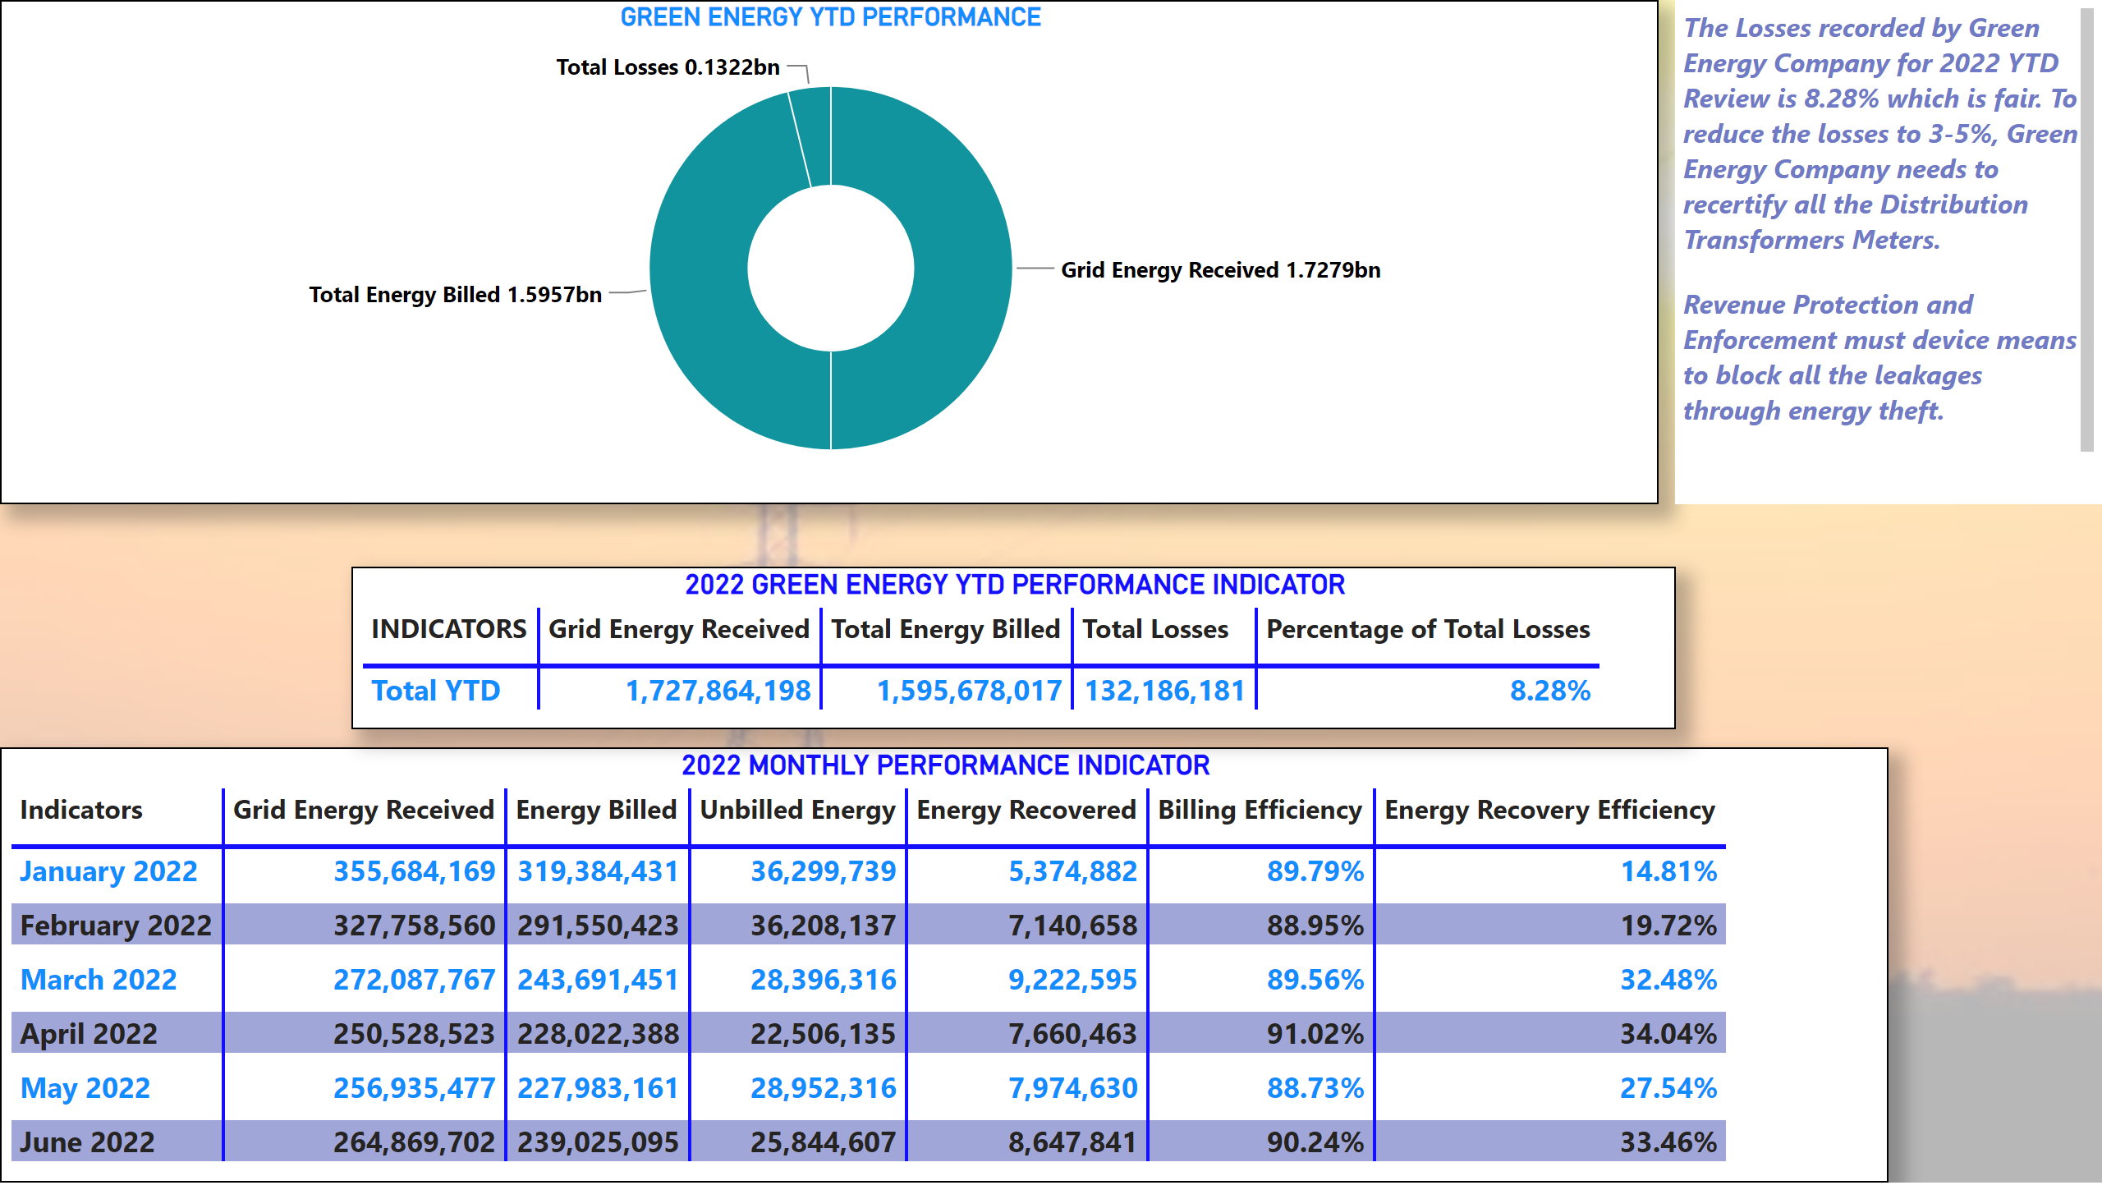
YTD PERFORMANCE INDICATOR
Notes:
2022 MONTHLY PERFORMANCE INDICATOR
No alt text provided
2022 GREEN ENERGY YTD PERFORMANCE INDICATOR
No alt text provided
GREEN ENERGY YTD PERFORMANCE
No alt text provided
textbox
No alt text provided

